Slide 1




5 Components of Usability
Analytics and Data Days
June 24–25, 2020
Nitika Uniyal and Sheena Lakshmi
SAP

Slide 2
Credits
Components Defined by the NN/g
  https://www.nngroup.com/articles/usability-101-introduction-to-usability/

Slide 3
Disclaimer
Examples provided in document are in the product as of January 30, 2020. Examples have been picked to illustrate concepts, and are not meant to be a critique to any individual development / design team.

Slide 4
Agenda
Defining Usability
  What and Why
User’s Critical Path
  Details
5 Components
  Understand the components with illustrated examples
Checklist
  Takeaway checklist
Appendix
  Additional examples

Slide 5
What is Usability?
According to the International Standards Organization (ISO)…
“Usability is the extent to which a product can be used by specified users to achieve specified goals with effectiveness, efficiency and satisfaction in a specified context of use.”
ISO 9241-11: Guidance on Usability (1998)
In other words, Usability is synonymous with comfort, it is a quality attribute that assesses how easy and efficient user interfaces are to use.

Slide 6
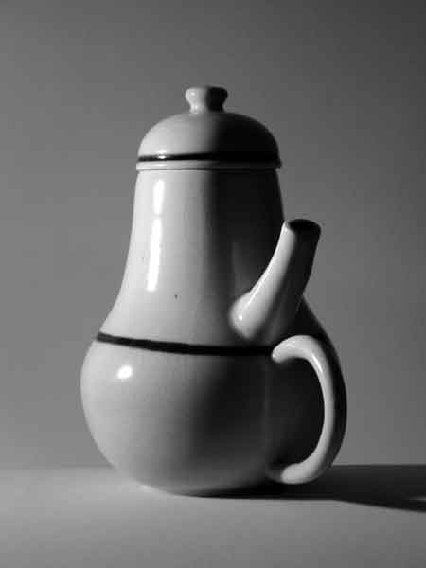
Why it matters to us?
Usability is a weapon that can save money, improve our competitive position, improve customer loyalty, decrease training and customer support.
Usability returns benefits in form of increased return on investment (ROI), if done at the beginning or during the product development lifecycle. As early usability defects are identified the less would be the cost of resolving them.
The impossible tea-pot - Jacques Carelman

Slide 7
but first..

Slide 8
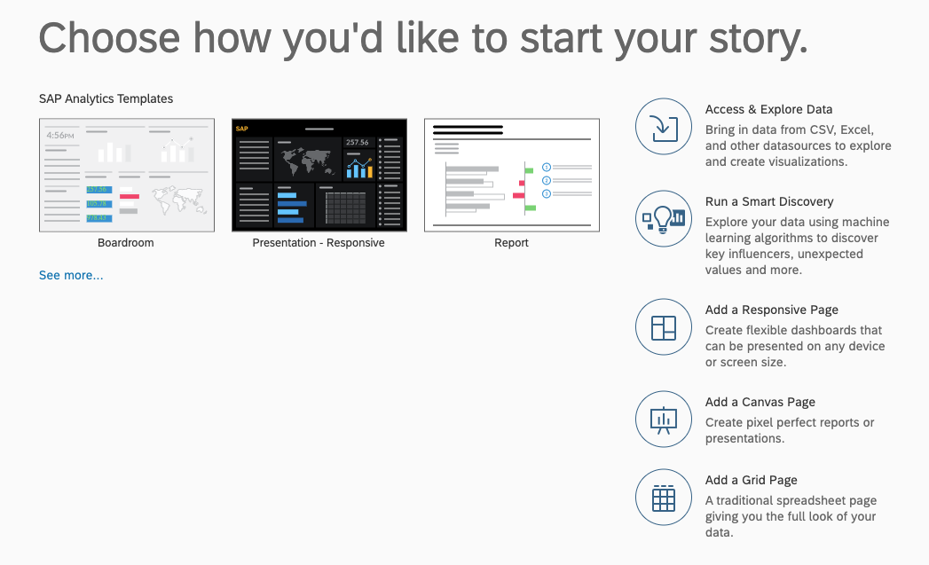
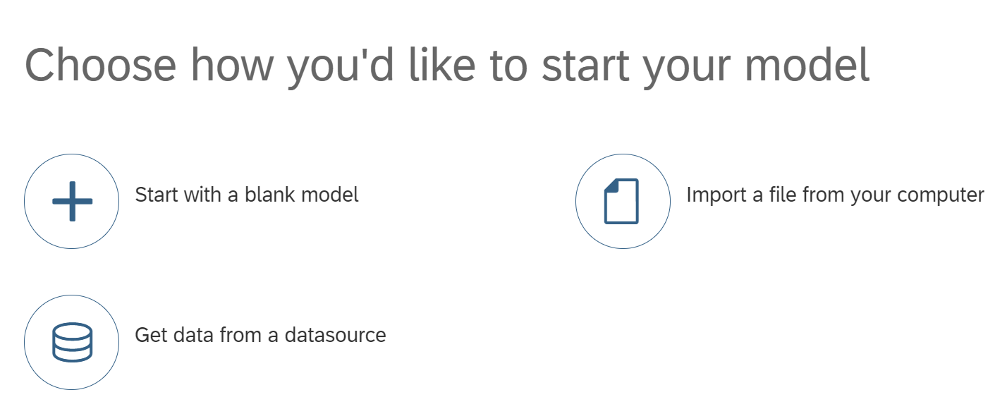
Understand User’s Critical Path
Understanding the most critical path in your users’ journey helps you help the user accomplish goals in a coherent, compact, sequential, and logical manner.

Slide 9

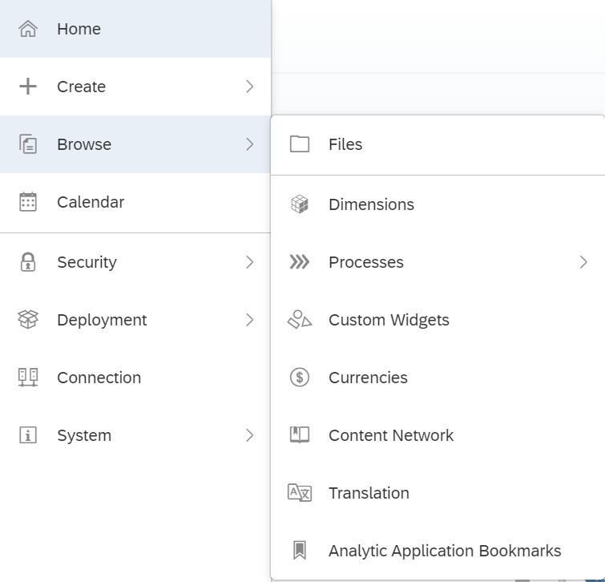
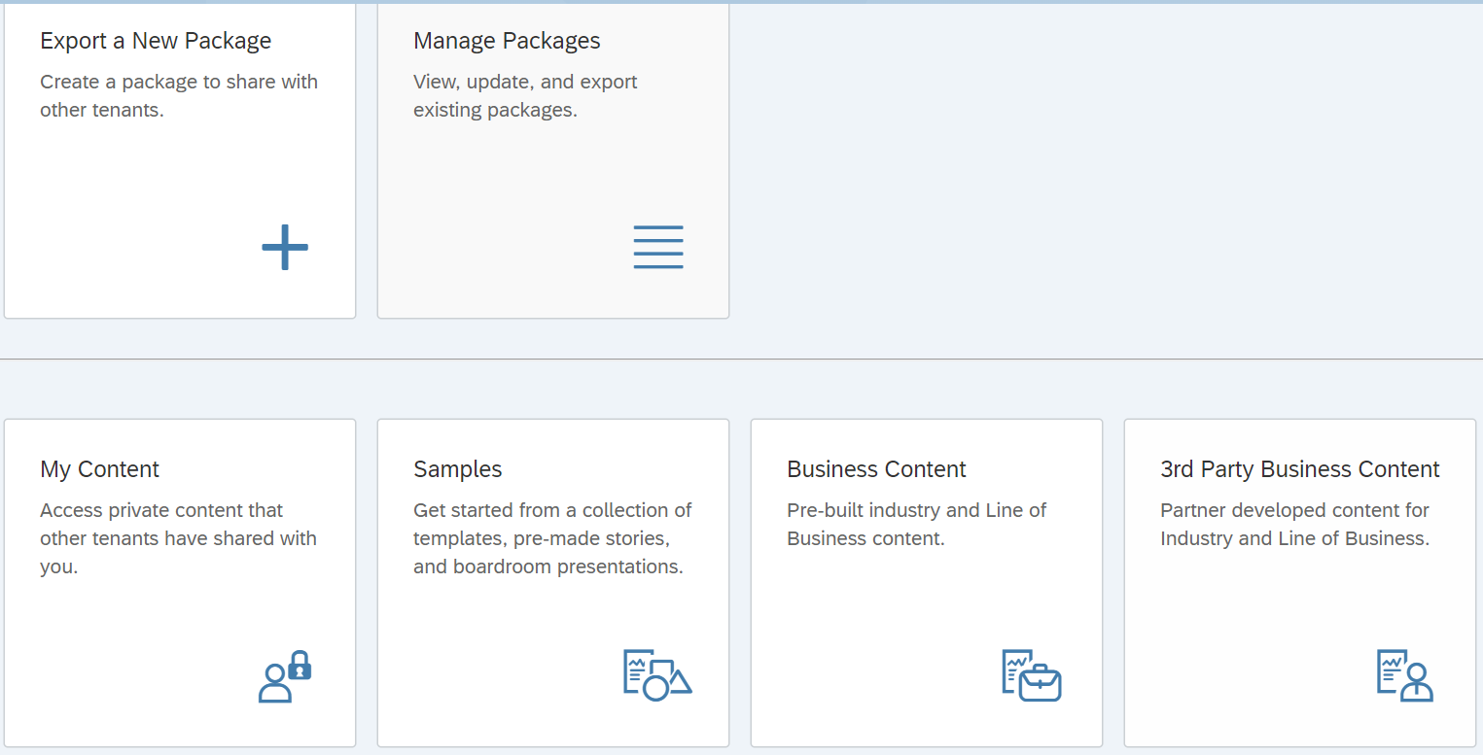
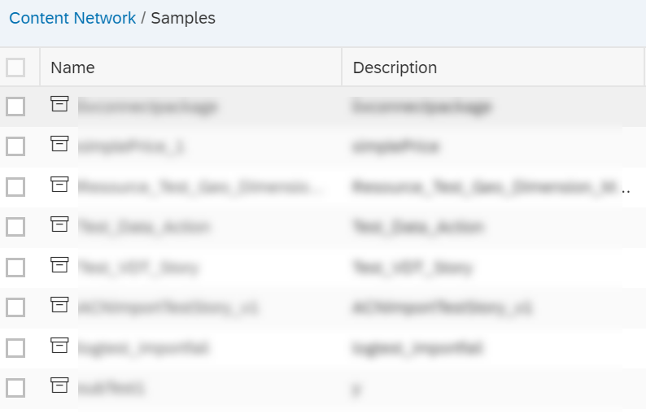
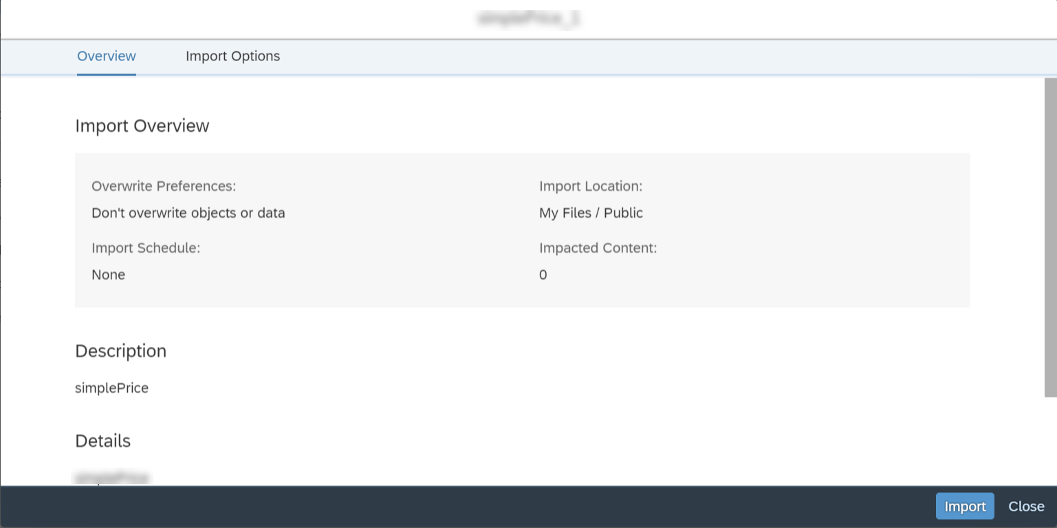
Understand User’s Critical Path

Slide 10
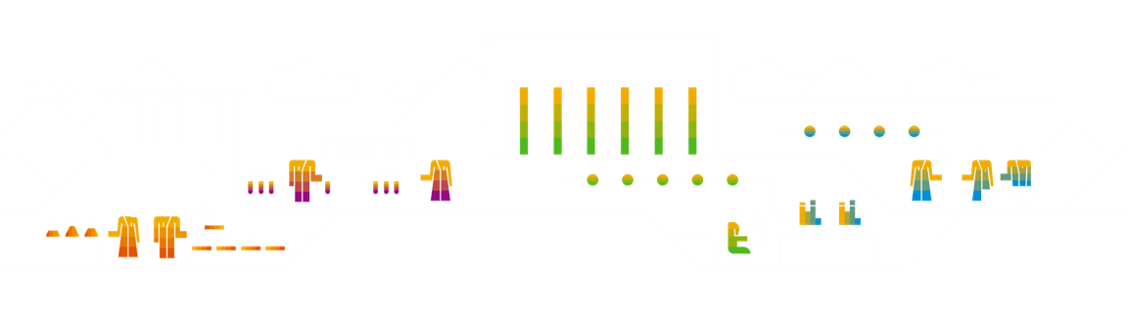
Efficiency
A user, familiar with an application, should be able to effectively and quickly accomplish goals in a logical, intuitive, and consistent manner.

Slide 11
Efficiency
Auto-Complete Steps
Provide Shortcuts
Anticipate Needs

Slide 12
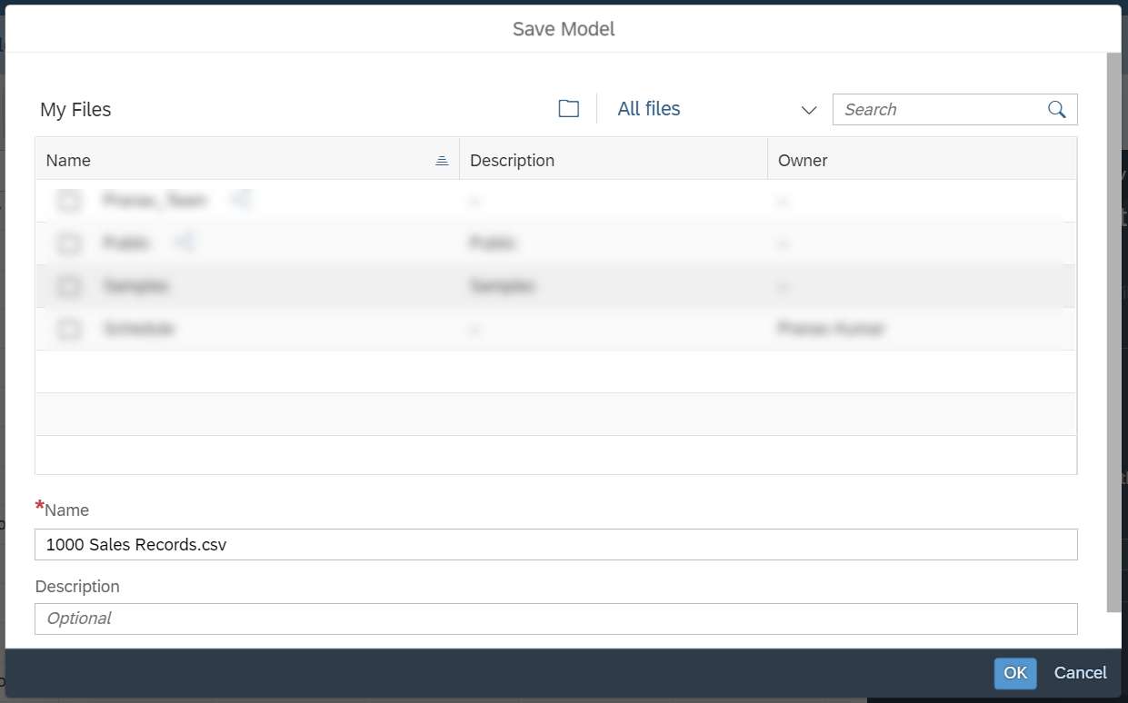
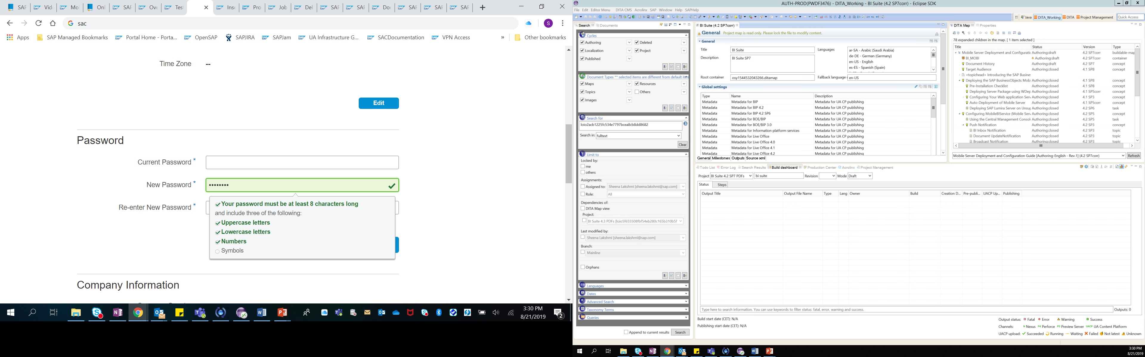
# 2 - Efficiency
Auto-Complete Steps | Provide Shortcuts | Anticipate Needs
Make tasks easier and shorter for your user by providing suggestions and auto-complete options and saving details for subsequent use.
Pre-populate data or provide defaults wherever applicable
Visible Password criteria to reduce error and speed up the process.
Notes:
For each step in your user experience flow, consider the following:
Is there a way to make this task simpler for users? Are we giving users too much information that might be confusing? Users equate simplicity to efficiency. When a workflow is simple, its easily relatable and efficient.
Is there a way to avoid users redo redundant tasks can we provide them with answers already and pre-fill it with existing data? Consider sign-up forms that could pre-populate with OpenID credentials, for example. How about providing assistance with password rules and not let users perform the tasks all over again if the password doesn't meet the guidelines. An efficient software is one, which prevents users from committing mistakes and make them feel at ease, make them feel valued and productive.

Slide 13
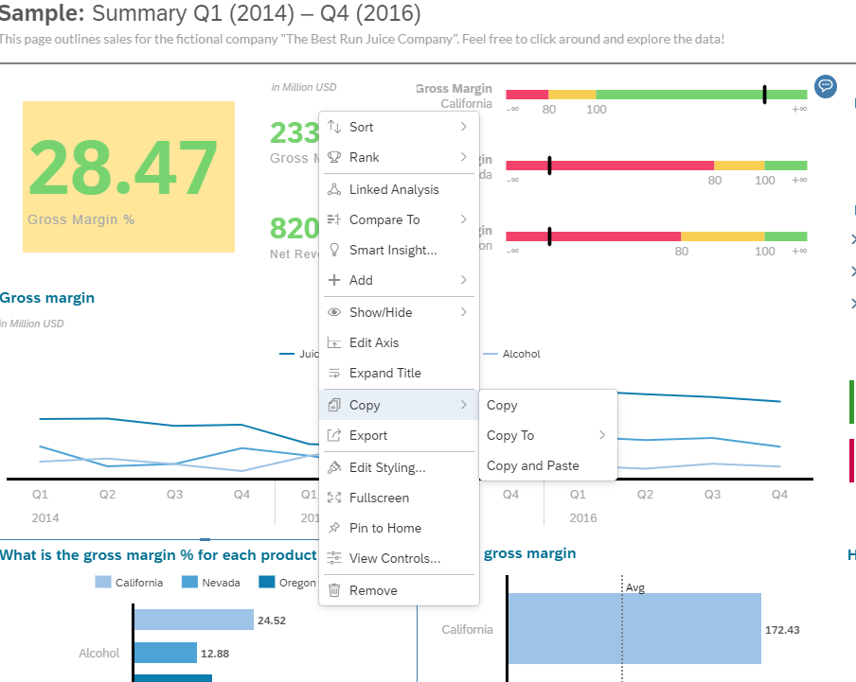
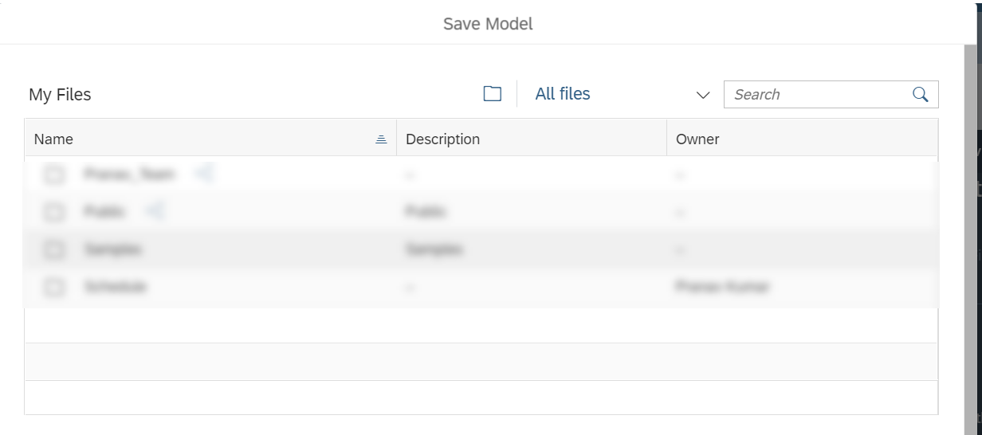
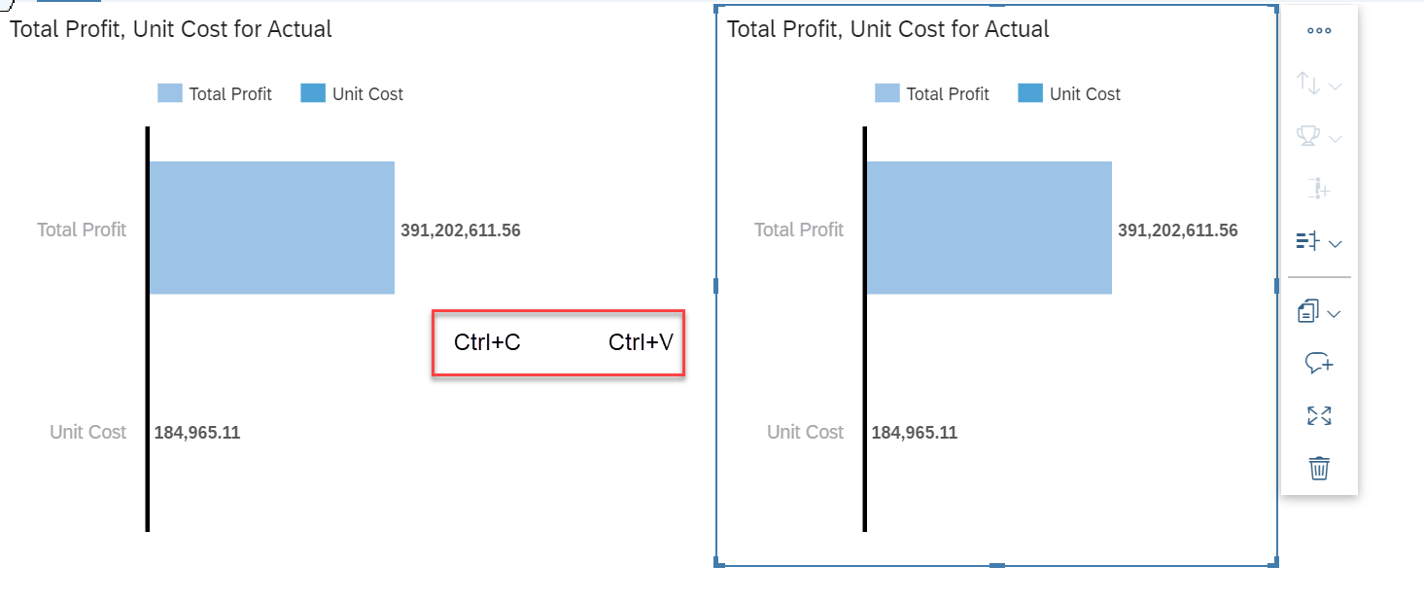
# 2 - Efficiency
Auto-Complete Steps | Provide Shortcuts | Anticipate Needs
Shortcuts within the application help users accomplish goals effectively and reduce churn.
Context menus for quick actions
Most commonly used shortcut for duplicating an item
Notes:
It is important to logically group tasks and provide users with commonly performed tasks that are intuitive or widely used in common applications, such as context sensitive help, commonly used keyboard actions and commands. Provide actionable items closer to the area of action to reduce cognitive load on users.

Slide 14
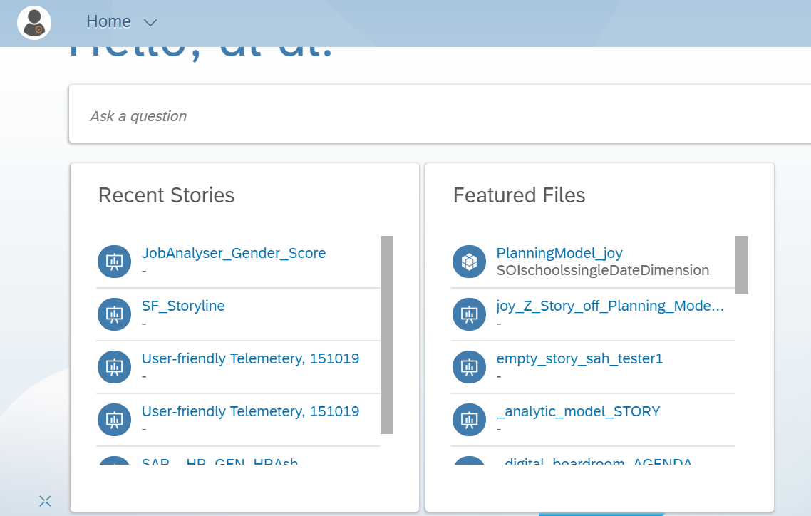
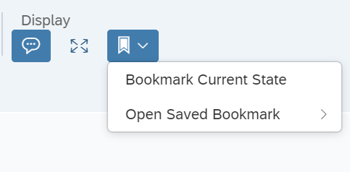
# 2 - Efficiency
Auto-Complete Steps | Provide Shortcuts | Anticipate Needs
​
Bookmarking a page to easily access it later
Recently accessed files on the Home page
Notes:
.
Shortcuts need not necessarily mean key board shortcuts or command options alone, it could imply providing the user with an easy and simple way of performing a mundane or repetitive task by simply reducing the number of clicks to achieve it. Something like a dashboard for recently accessed files, or recently performed actions, it could also mean the popular feature of bookmarking favourite workflows.

Slide 15
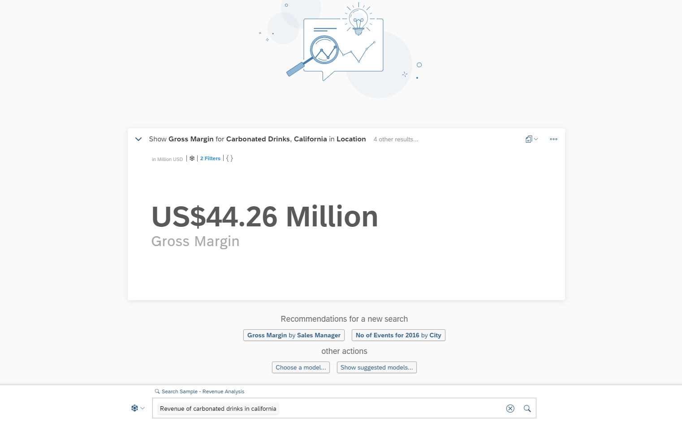
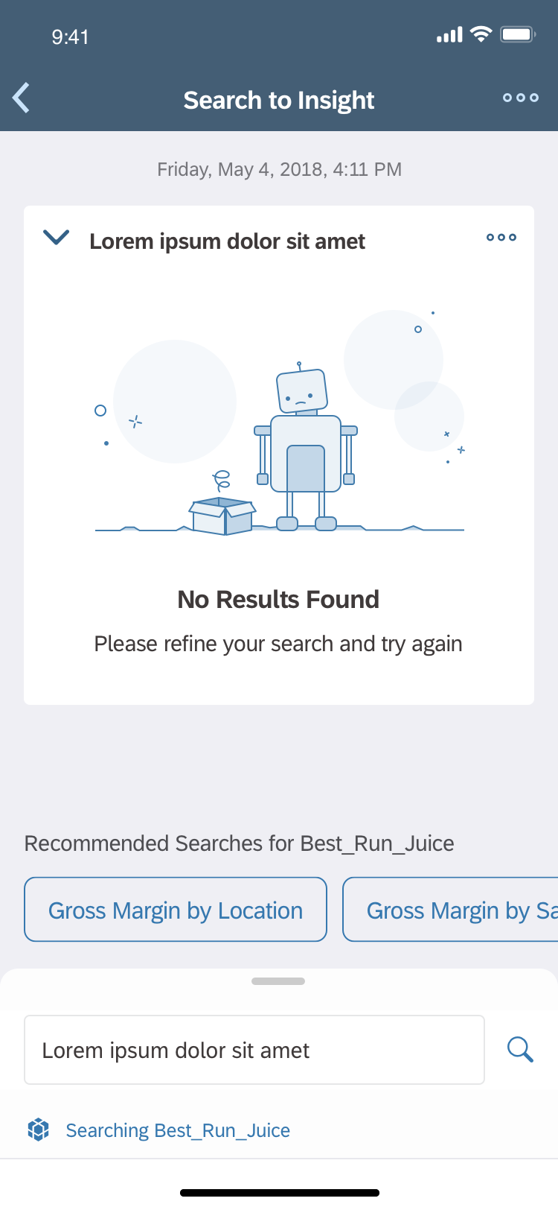
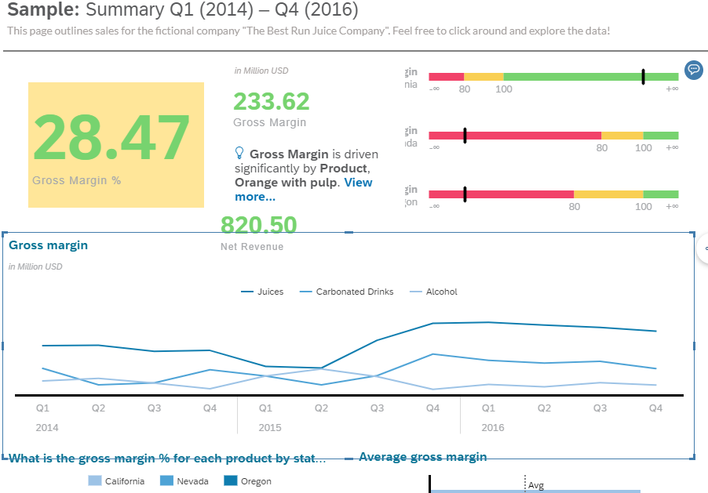
# 2 - Efficiency
Auto-Complete Steps | Provide Shortcuts | Anticipate Needs
​Guide your users based on the common course of action for accomplishing a task and if possible, provide an anticipatory design that enables machine intelligence to do it for them. Provide them with what they expect.
​
Keep users informed that they are looking at relevant data.
Search o Insight Queries and recommendations are great to guide users
Search to insight (Mobile)
Notes:
Recommendations are great to guide users. Smart insights does the thinking and helps users in coming up with insights for their business.
Anticipatory design’s promise is the elimination of friction and an increase in efficiency that would greatly improve user experiences, and in turn impact the bottom line. People return to products and services that deliver what they want when they want it.
Can we suggest a course of action based on previous preferences?
Can we save the user some time by using templates that have been created before?
Is there any extra value that we could add given the user’s action in this step?
How can we prevent the user from making a mistake here, or provide alternative options before the mistake is made?

Slide 16
Memorability
Memorability is a measure of how easy an application is to remember after a substantial time-lapse between visits.

Slide 17
Memorability
Visual Elements
Response Times
Pattern Affordances

Slide 18
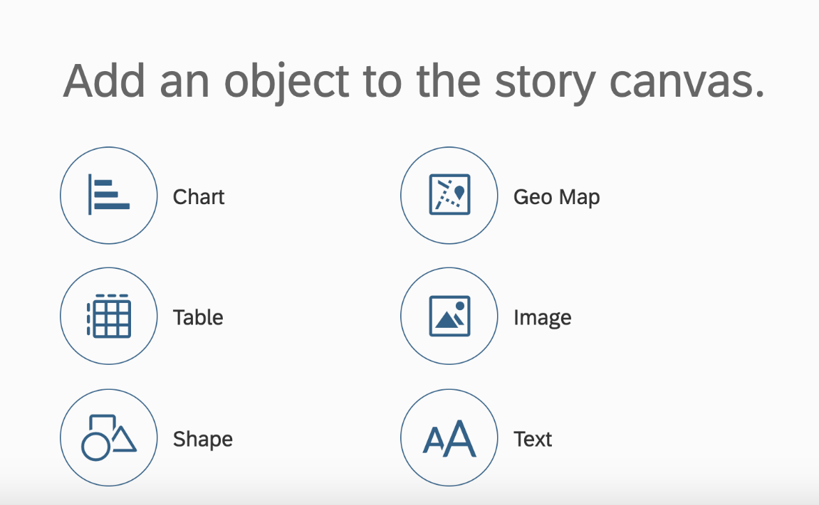
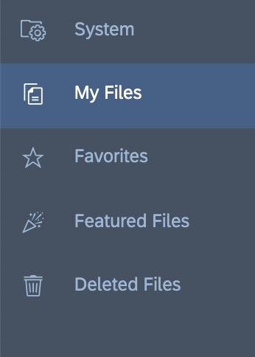
# 3 - Memorability
Visual Elements | Response Times | Pattern Affordances
Response times must be fast enough such that users don't get distracted and digressed from the main task while they are waiting for the next page to load. Keeping the response times within workflows short also helps in retaining the memory of the workflows.
Iconography
* Refer to Appendix for more information on Icon usage
Notes:
Icons can be effective when they are used to improve visual interest and grab the user’s attention.
Icons to be used when there is a space constraint like in toolbars or contextual menu, palettes, and so on to display many icons in a relatively small space
Provide Functionality and Feedback. Imagine a video player with the words play and pause compared to the icons currently used. Icons allow us to communicate an idea quickly
Pair complex action icon or unfamiliar icons with text

Slide 19
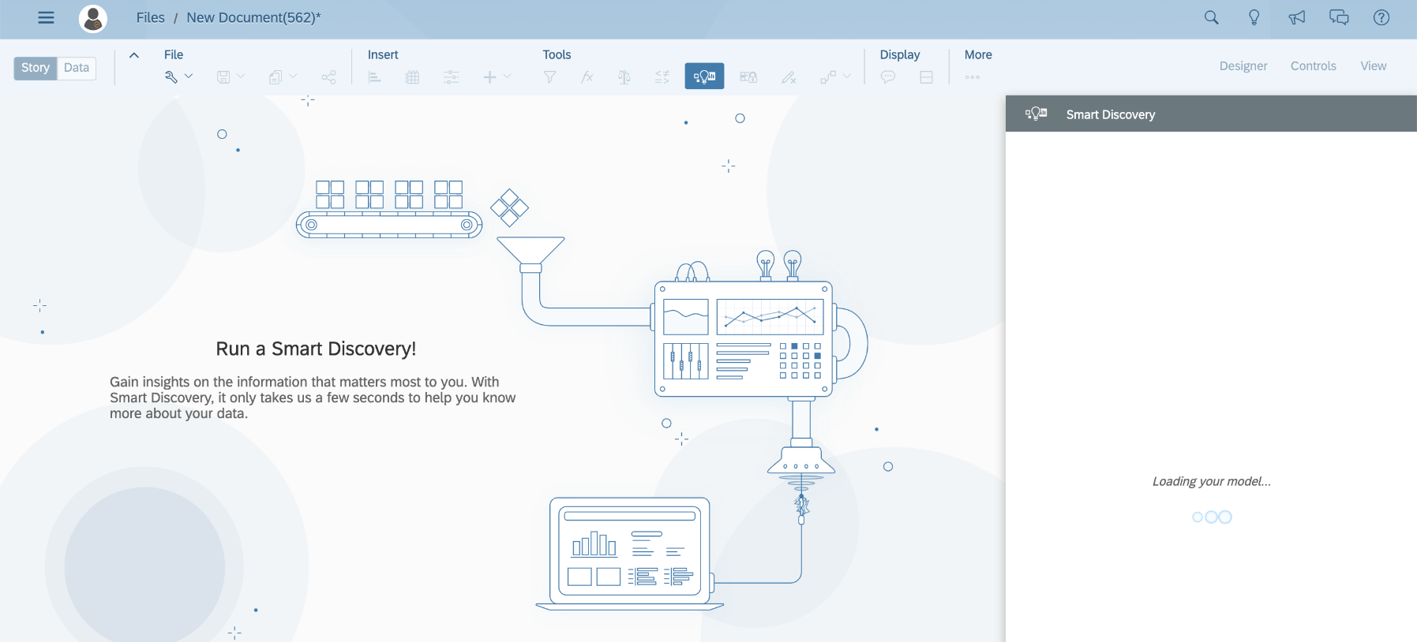
# 3 - Memorability
Visual Elements | Response Times | Pattern Affordances
Response times must be fast enough such that users don't get distracted and digressed from the main task while they are waiting for the next page to load. Keeping the response times within workflows short also helps in retaining the memory of the workflows.
Placeholders and system status
In case the waiting time for the page load is longer, it would be ideal to have micro animations like loading indicators informing the user about current status.
Notes:
Helps users to not loose track of what they are currently doing.

Slide 20
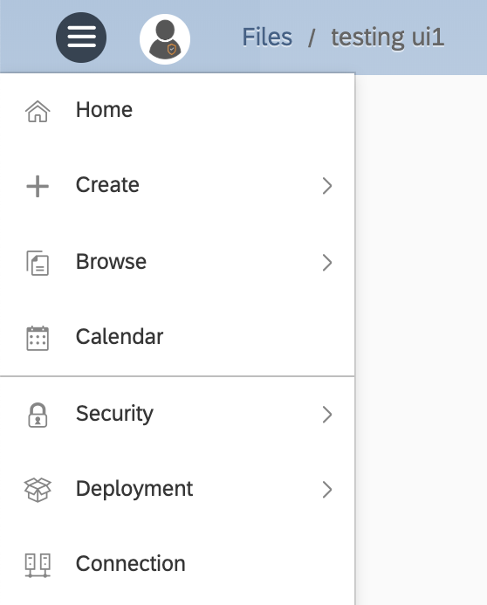
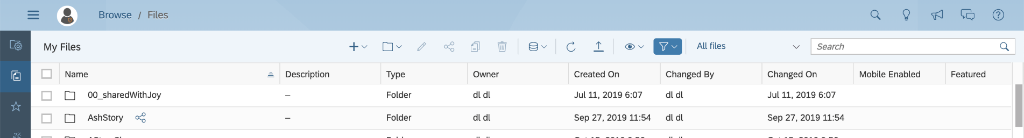
# 3 - Memorability
Visual Elements | Response Times | Pattern Affordances
Pattern affordances are based on the power of habit and their biggest advantage is saving the effort on memory. Reusing established patterns helps a user to easily recognize and use similar patterns elsewhere in the application.
Known Web Patterns
User icon contains information about user profile
Breadcrumbs for navigation
Search, Notifications, help to be globally available
A table/list of content should look and follow a standard table/list behavior
Hamburger menu allows users to navigate to important sections of the application
Notes:
Known Web Patterns – Web patterns are universally accepted and users have a mental model for it because of various web and mobile interactions. For example we recognise hamburger menu from our experience with mobile apps. We recognise user icon because of our experience with social media websites liek facebook, instagram, linkedin etc where a user icon holds profile info.

Slide 21
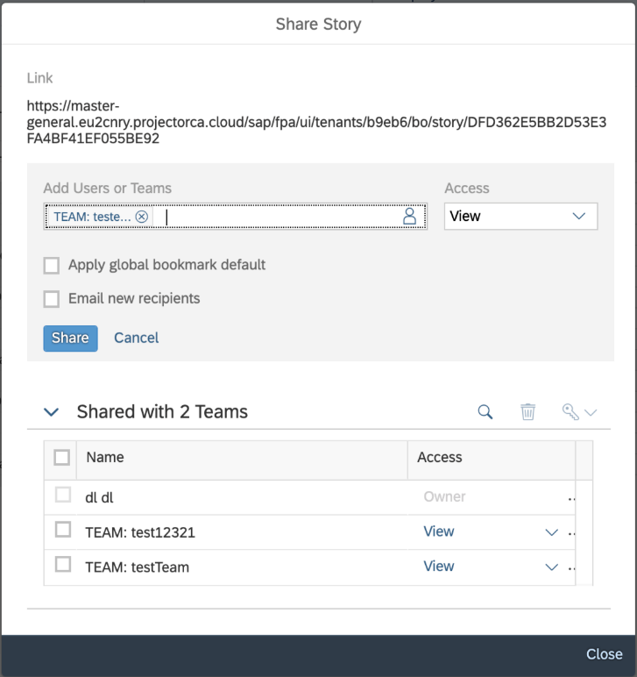
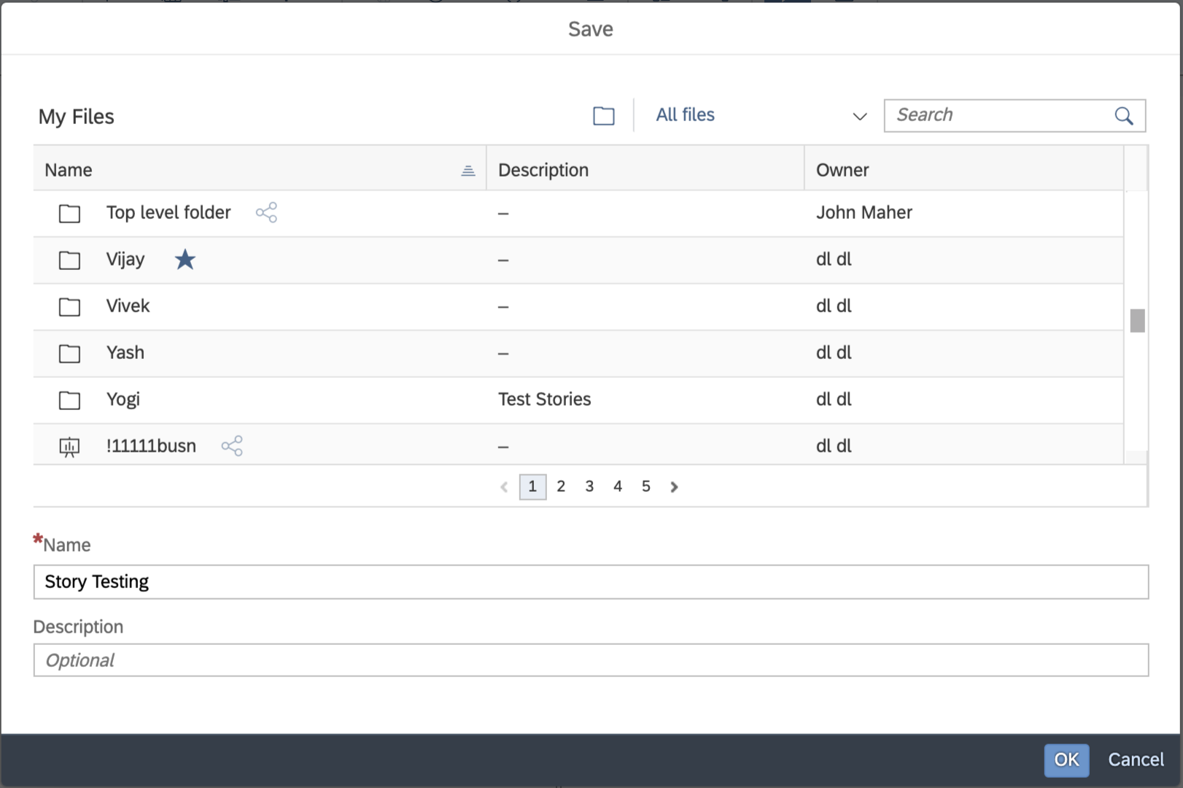
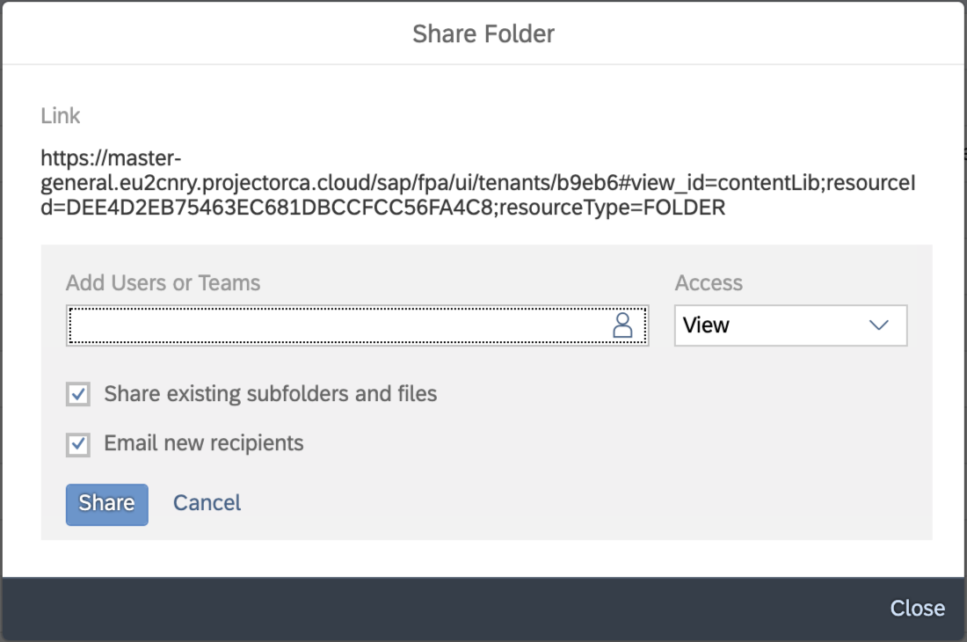
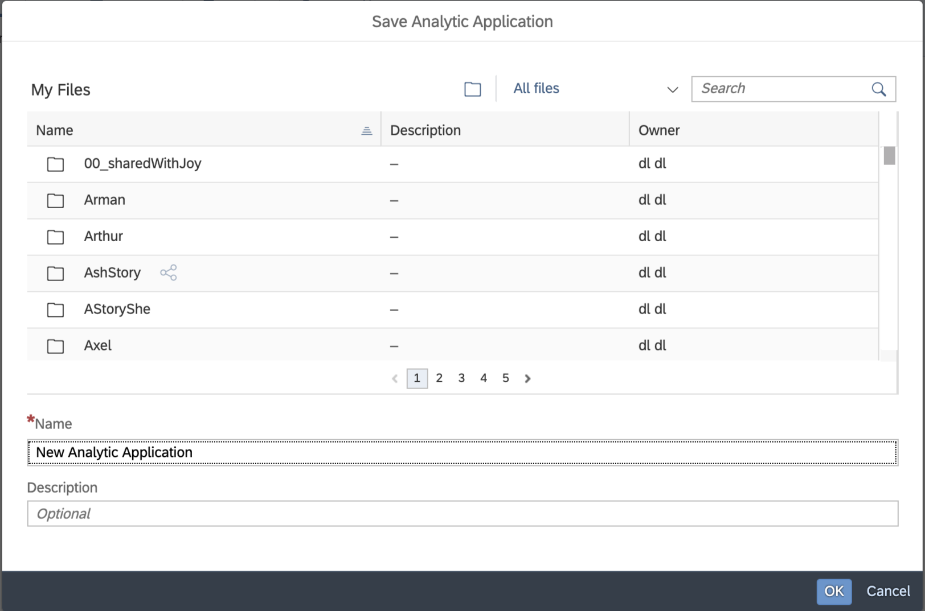
# 3 - Memorability
Visual Elements | Response Times | Pattern Affordances
Maintaining patterns within the application – Reuse
Share Dialog
Save Dialog
Notes:
For commonly used workflows and scenarios reuse and maintain the same pattern within the application. For example share and save is a common scenario that may come in multiple places within your application. Do not create different ways for performing the action, instead maintain the same pattern for the same workflows.

Slide 22
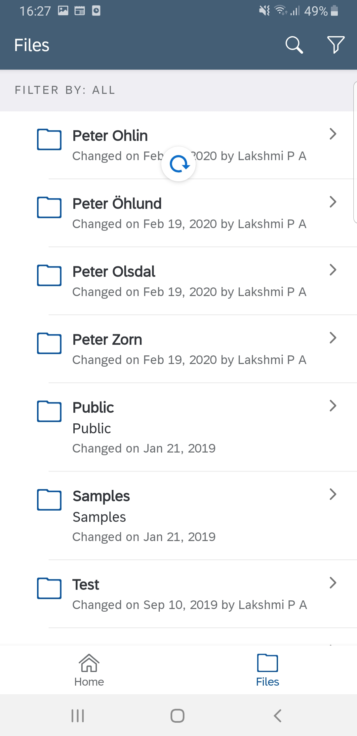
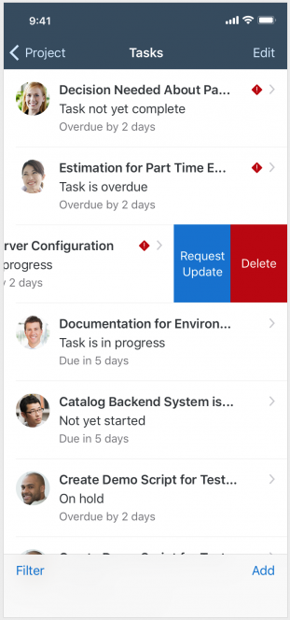
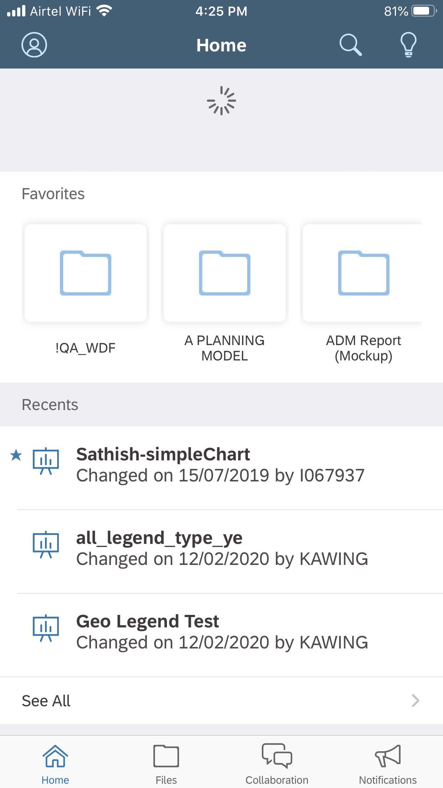
# 3 - Memorability
Visual Elements | Response Times | Pattern Affordances
Universal Mobile Behaviour – Pull to refresh
iOS pattern – Swipe gesture for quick actions
Notes:
For mobile apps as well, make use of established mobile behaviors and interactions like pull to refresh. This is a common mobile behavior universally accepted. Apart from replying on established mobile behaviors also respect existing OS patterns like in iOS, a swipe gesture reveals quick actions, and build around these patterns for better memorability.

Slide 23
Satisfaction
The sense of completion users experience when an application meets or exceeds their expectations and helps them successfully complete their tasks.

Slide 24
Satisfaction
Celebrating your users
Understanding Metrics

Slide 25
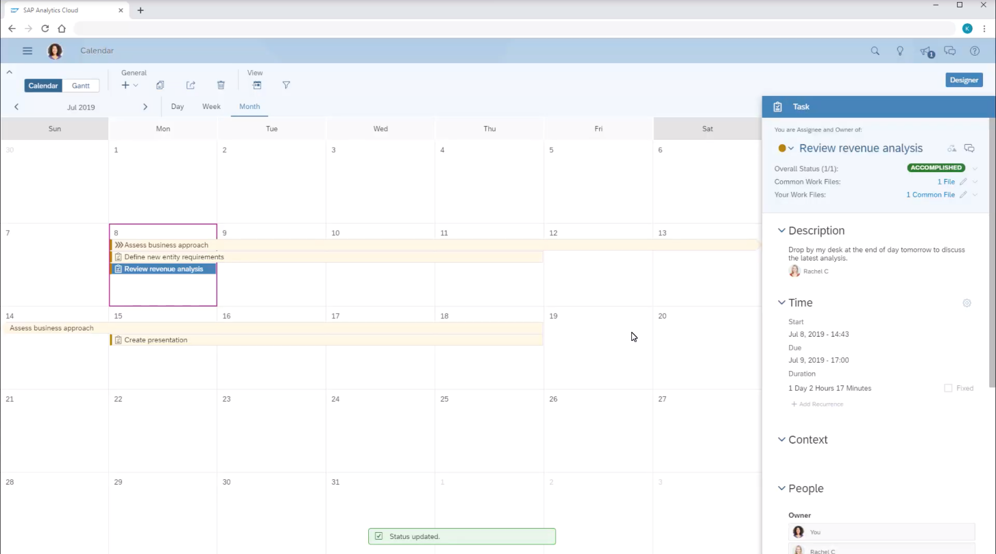
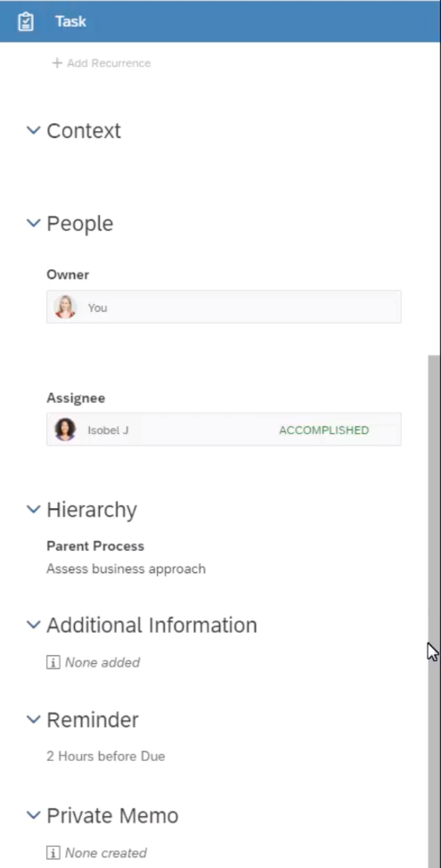
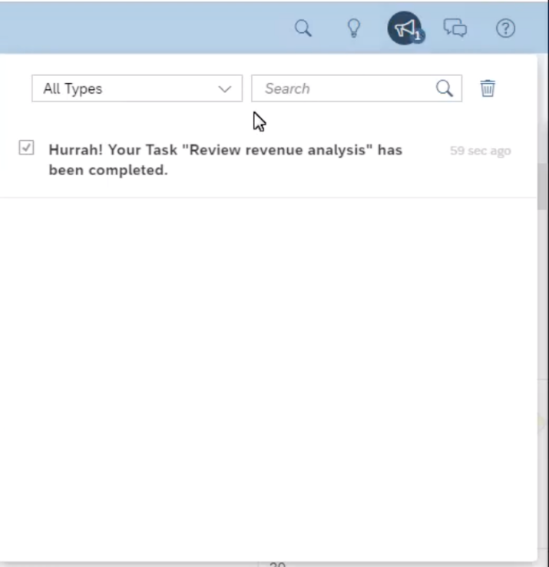
# 5 - Satisfaction
Celebrating Your Users
Understanding Metrics
Acknowledging different user roles, user’s effort and task progress leads to greater user engagement and user satisfaction. This in turn helps remind users of the value and impact of our product and makes them want to complete tasks again and again.
Acknowledge small wins
Success toast message and positive status change
Celebratory notifications
Notes:
Celebrating your user, talks about acknowledging different user roles, user’s effort and the progress made which in turn leads to greater user engagement and user satisfaction. Once acknowledged, users feel encouraged to perform the task again and again. This also instills the value and impact of the product in the users' mind, which also contributes to user satisfaction.

Slide 26
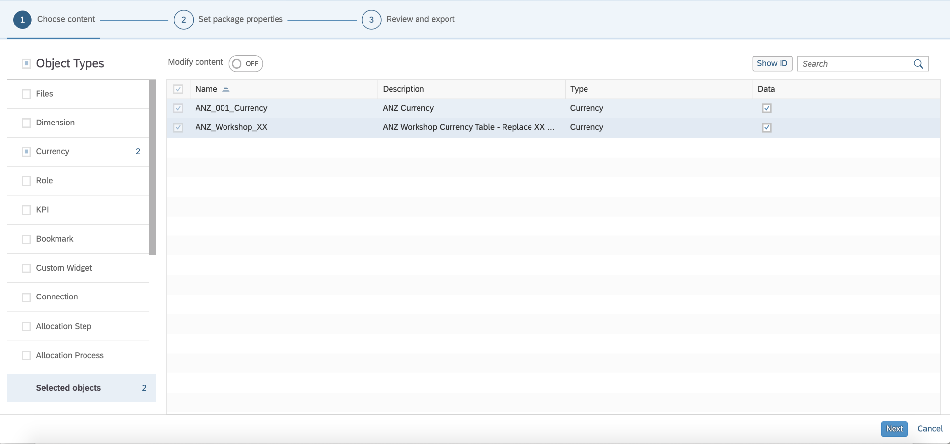
# 5 - Satisfaction
Celebrating Your Users
Understanding Metrics
Continual moments of satisfaction
Step-by-step process/wizard
Notes:
User satisfaction is hard to sustain over long, tedious workflows or tasks. Break down complex tasks and workflows into small, manageable chunks and create continual moments of satisfaction.

Slide 27
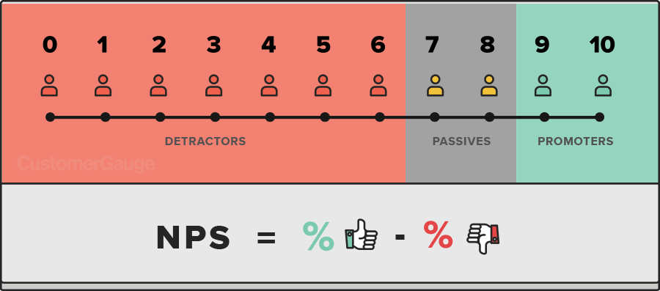
# 5 - Satisfaction
Celebrating Your Users
Understanding Metrics
Customer satisfaction metrics refers to how happy customers are with the product. It reflects the way customers feel during interactions, as well as the way they feel while using a product and its services.
Net Promoter Score
NPS is a standardized scoring system that helps companies gauge customer loyalty and overall health of the customer experience. The score allows us to discover insights about our customer loyalty and identify customer experience weak points.
Notes:
We also want to touch upon metrics

Slide 28
CHECKLIST
Understand User's Critical Path
  Has the workflow been designed keeping in mind the essential steps a user will need to take for accomplishing a task in a manner that is…
      … coherent
      … compact
      …sequential
      …logical
1 Learnability
  Is the system equipped with elements that will enable the user to learn it quickly using…
      …onboarding techniques by providing interactions and instructions that help the user ease into the product's experience
      …appropriate design conventions that incorporate familiar and easy-to-understand icons and layouts
      …easily accessible controls such as highly visible commands and menu options
2 Efficiency
  Can the system assist the user in accomplishing goals in a logical, intuitive, and consistent manner by…
      …providing auto complete options
      …incorporating commonly used shortcuts via keyboard or available as menu options
      …anticipating actions and providing the users with what they expect

Slide 29
3 Errors
  Is the feature spared from preventable and unnecessary error by employing…
      …constraints limited to only valid user inputs and actions?
      …suggestions used to reduce the amount of manual user input?
      …default labels, values, states, and actions used to the user’s advantage?
      …forgiving formatting for all input fields?
4 Memorability
  Does the design enable your users to recollect the workflows and quickly perform tasks owing to…
      …Familiar visual elements that build a strong mental model among users, which in turn helps them in processing, retaining, and remembering patterns and workflows easily
      …Lesser response times that leave lesser room for distraction from the main task
      …Established patterns that are reused in similar elements so that they are easy to recollect and relate with familiar patterns and workflows
5 Satisfaction
  Is the design convincing enough so as to offer the users a sense of completion and contentment after a task is performed by way of…
      …metrices that can quantify the satisfaction parameters
      …engaging and celebrating the user after accomplishing simple tasks

Slide 30
Thank you.
Contact information:
  F name L name
  Title
  Address
  Phone number
Partner logo

